Slide 1
More standard and layout widgets
Lecture #4

Slide 2
Let us look at some more Standard widgets

Slide 3
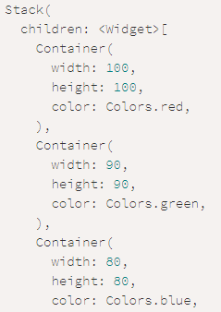

Stack
Quite easy to guess what a stack does

Slide 4
Stack
Stack covers the entire space available to it.
By default, it lays each of its children at the top start (top left).
We can align its children by Align widget.

Slide 5


Stack
Also made with Stack. Can you implement them?

Slide 6
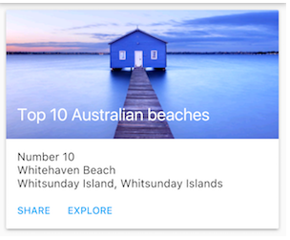
Card
The Card widget is a panel with slightly rounded corners and an elevation shadow.
Apart from rounded corners and elevation, everything else has to be implemented.

Slide 7
Flutter Lists

Slide 8
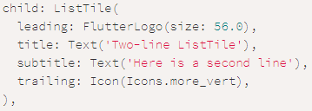


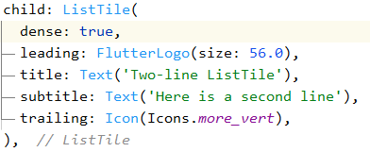
List Tile

Slide 9
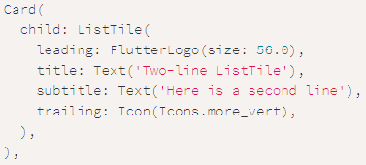

Combining Card and ListTile
List tile is often added as a child of Card, which looks great.

Slide 10
Creating a list
Let’s see how we can easily create a list using what we have learnt so far.
Surely, we can make a list using rows and columns, but Flutter gives us something to make it faster and easier.
For that, we use ListView. ListView’s “children” property accepts an array of Widgets which it displays as a list and makes it scrollable.
Let us see how we can make lists using Card and ListTile

Slide 11
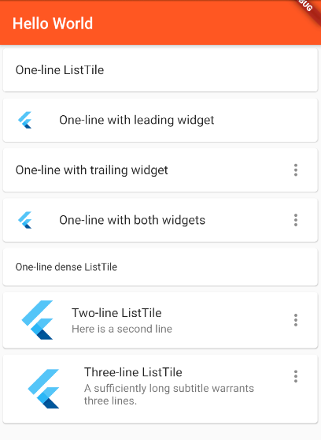
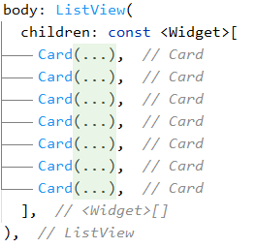
Creating a list

Slide 12
Example
@override
Widget build(BuildContext context) {
return Scaffold(
appBar: AppBar(title: const Text("ListView.builder")),
body: ListView.builder(
itemCount: 5,
itemBuilder: (BuildContext context, int index) {
return ListTile(
leading: const Icon(Icons.list),
trailing: const Text(
"GFG",
style: TextStyle(color: Colors.green, fontSize: 15),
),
title: Text("List item $index"));
}),
);
}
}
import 'package:flutter/material.dart';
void main() => runApp(const MyApp());
class MyApp extends StatelessWidget {
const MyApp({Key? key}) : super(key: key);
// This widget is the root
// of your application.
@override
Widget build(BuildContext context) {
return MaterialApp(
title: "ListView.builder",
theme: ThemeData(primarySwatch: Colors.green),
debugShowCheckedModeBanner: false,
// home : new ListViewBuilder(), NO Need To Use Unnecessary New Keyword
home: const ListViewBuilder());
}
}
class ListViewBuilder extends StatelessWidget {
const ListViewBuilder({Key? key}) : super(key: key);

Slide 13
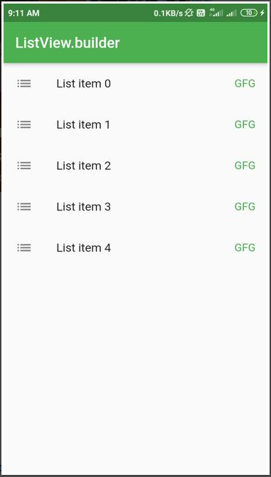
Example Output

Slide 14
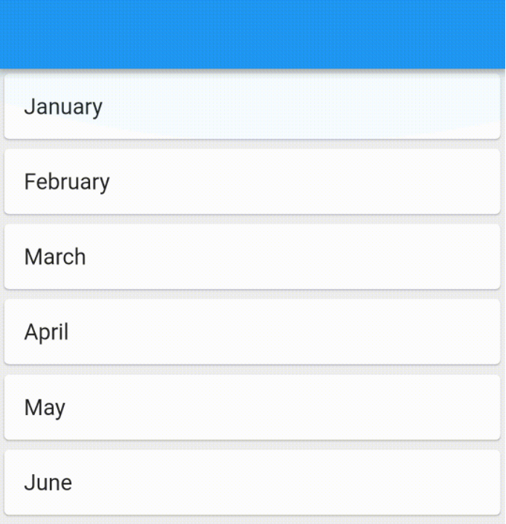
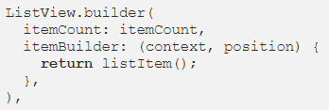
ListView.builder
The builder() constructor constructs a repeating list of items.
The constructor takes two main parameters: An itemCount for the number of items in the list and an itemBuilder for constructed each list item.

Slide 15
ListView.builder
The list items are constructed lazily, meaning only a specific number of list items are constructed and when a user scrolls ahead, the earlier ones are destroyed.
Since the elements are loaded lazily and only the needed number of elements are loaded, we don’t really need an itemCount as a compulsory parameter and the list can be infinite.

Slide 16
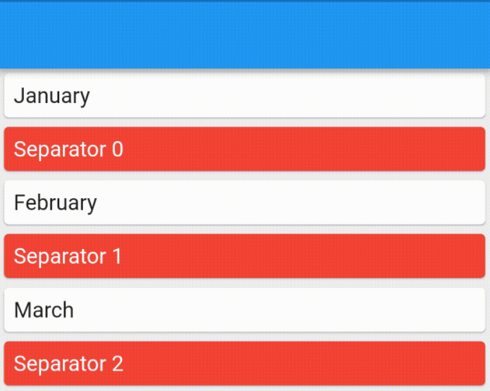
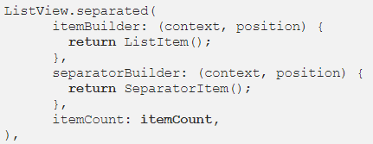
ListView.separated
In the separated() constructor, we generate a list and we can specify the separator between each item.

Slide 17
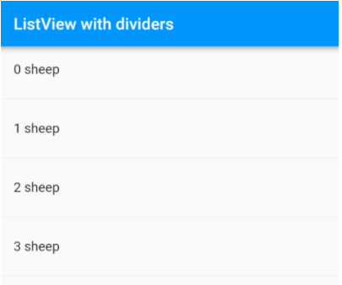
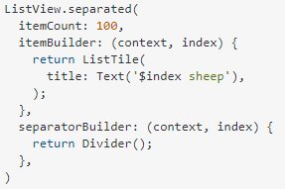
ListView.separated
Or we can have the same separator everywhere.
Notice the thin line between item. It is called a Divider

Slide 18
Flutter Icons

Slide 19
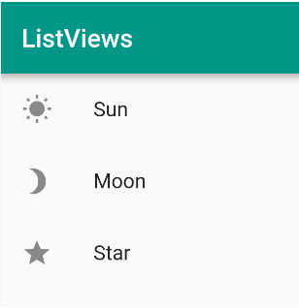
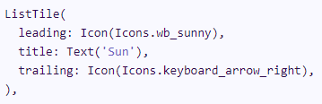
Adding Icons
Icons can be added with the Icon Widget.
You can find the Icons at https://www.materialpalette.com/icons
The syntax is - Icon(icon_id)
You can customize Icon size, color, etc.

Slide 20
Boss level challenge

Slide 21
Boss level challenge
If you haven’t, go back to the start of the presentation, and implement each example that you see.
Remember that you are not forced to make xerox copies of what you see. Feel free to be creative with your design.
When ready, move to part two.

Slide 22
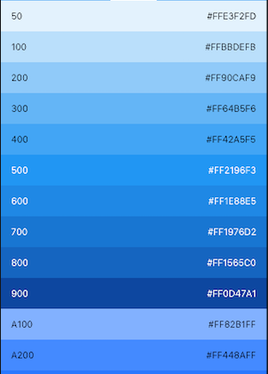
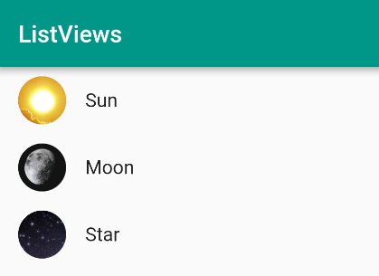
Boss level challenge
Now, for part two of your challenge -

Slide 23
Ultra boss level challenge (Optional)

Slide 24
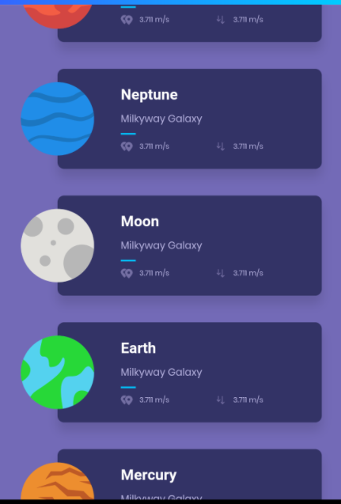
Ultra boss level challenge (optional)
Implement a list as shown to help children memorize the names of planets (okay, maybe not the moon. Just the planets)
Include two more pieces of information. Like the distance from sun and the orbital speed.
As always, feel free to be creative and unique!

Slide 25
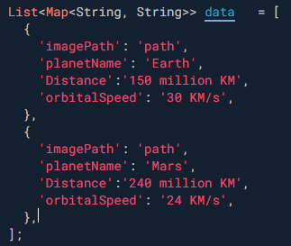
Ultra boss level challenge (optional)
For tasks like this, store the data in an array of maps -
And build the list using listview.builder

Slide 26
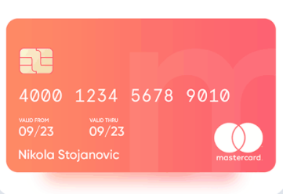
Ultra boss level challenge (optional)(2)
Make a credit card in flutter. Don’t forget the shadow, the gradient, the light ‘m’ in the background, and the icons/photos and owner details.

Slide 27
Thank you!

